Slide 1
Tensorflow.js and brain.js

Slide 2
agenda
Introduction
CNNs
TensorFlow.js and Brain.js
Examples
Takeaways

Slide 3
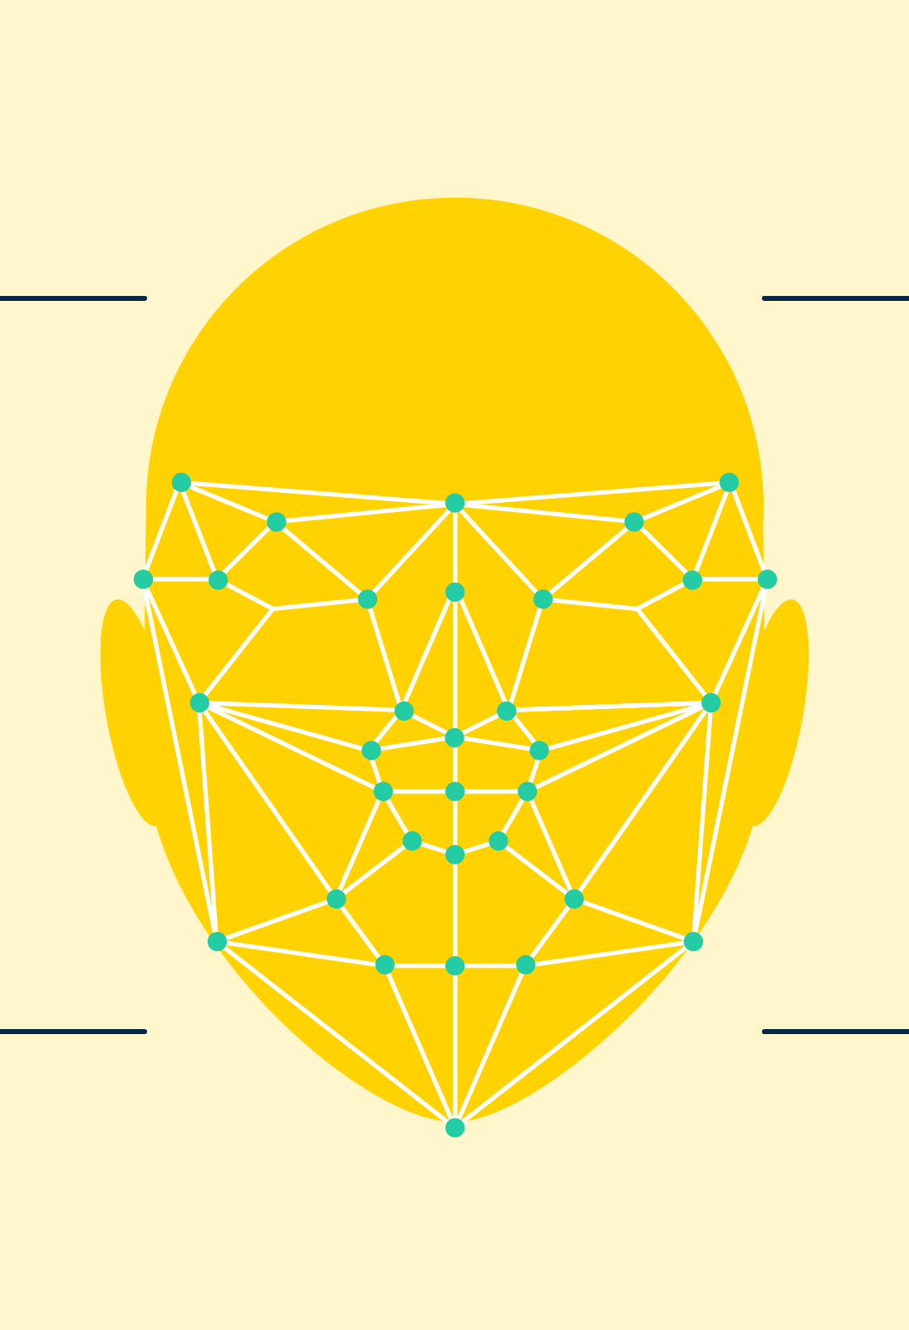
The power of image recognition and object detection

Slide 4
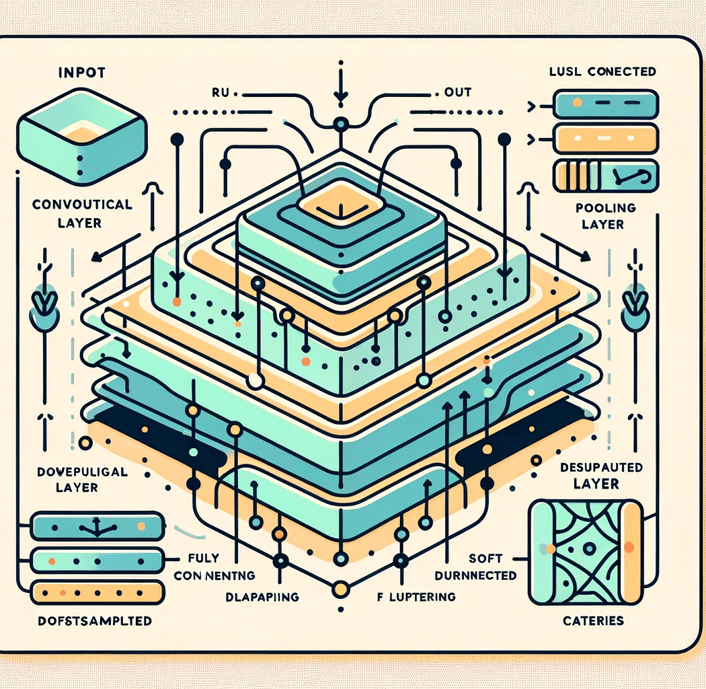
convolutional neural networks
Feature selection:
Convolutional layer
Pooling layer
Classification/Regression
Fully-connected layer

Slide 5
Brain.js
Brain.js is a lightweight neural network library for JavaScript, designed for simplicity and ease of use.
It is suitable for quick prototyping and smaller machine learning tasks.
Strengths: Simplicity, Ease of Integration, Visualization
Limitations: Performance, Limited Functionality
npm install brain.js
or
<script src="//unpkg.com/brain.js"></script>

Slide 6
Tensorflow.js
TensorFlow.js is a more comprehensive and powerful library for machine learning in JavaScript, developed by Google. It allows you to develop and execute ML models in the browser and Node.js, leveraging TensorFlow’s powerful ecosystem.
Strengths: Performance, Flexibility, Pre-trained Models, Extensive Ecosystem
Limitations: Complexity, Size
The Tensor class
npm install @tensorflow/tfjs
or
<script src="https://cdn.jsdelivr.net/npm/@tensorflow/tfjs@latest/dist/tf.min.js"></script>

Slide 7
Examples with tensorflow.js and brain.js
Gesture recognition and Macedonian sign language detection

Slide 8

Gesture recognition
Handpose model
Fingerpose library
21 hand landmarks
Thumbs up gesture
Victory gesture
Tutorial by Nicholas Renotte
Real time AI Hand pose estimation and Gesture recognition
feature/handpose-detection

Slide 9
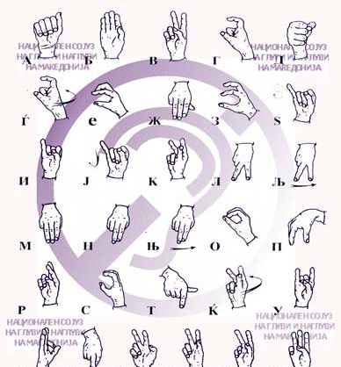
One handed Macedonian sign language recognition
This model leverages TensorFlow.js and the HandPose model as its foundational base. By incorporating Brain.js and applying transfer learning techniques, the model is trained to recognize the first five letters from the one-handed Macedonian sign language alphabet.
Input layer: 128 neurons, ReLU
Output layer: 5 neurons, Softmax
feature/one-hand-msl-detectio

Slide 10
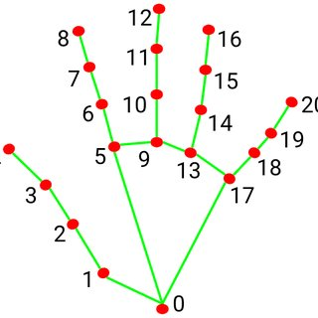
two handed Macedonian sign language recognition
In this example TensorFlow.js is used to load a pre-trained base model, specifically MobileNet, to generate image features that can be used in transfer learning, and then to create and define a multi-layer perceptron that takes the image features and learns to classify new objects using them. On the other hand, this example uses the HandLandmarker model from MediaPipe to detect the landmarks on both hands.
Input layer: 128 neurons, ReLU
Output layer: 5 neurons, Softmax
feature/two-hand-msl-detection

Slide 11
takeaways
The field of machine learning (ML) is rapidly expanding
Growing potential and versatility of ML in accessible environments
Particularly significant application in the realm of sign language translation
Browser-based ML technologies continue to evolve
Key points:
ML
Browser
Versatility
Accessibility
Sign Language

Slide 12
Thank you
Matej Melovski (216034)
Mila Slavkovska (216067)

